Slide 1
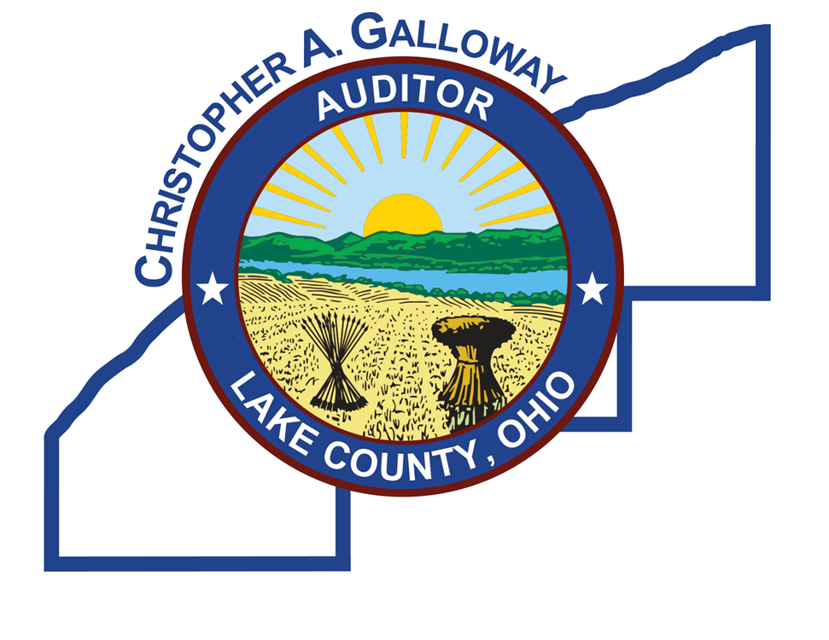
Property Taxes
Where are we going?

Slide 2
Property Taxes
Where are we going?
What’s occured
What’s aHEAD

Slide 3
Legislation passed
Budget Bill – H.B. 96
Bills signed by the Governor on December 19, 2025 (effective March 20, 2026)
H.B. 124 – County Auditor Control of Property Valuations
H.B. 129 – Calculation of the Floor
H.B. 186 – Limitation on Floor Increases to Inflation, Modification of Credits
H.B. 309 – Expands Authority of County Budget Commissions
H.B. 335 – Limitation of Inside Millage Increases to Inflation Recent Property Tax Legislation

Slide 4
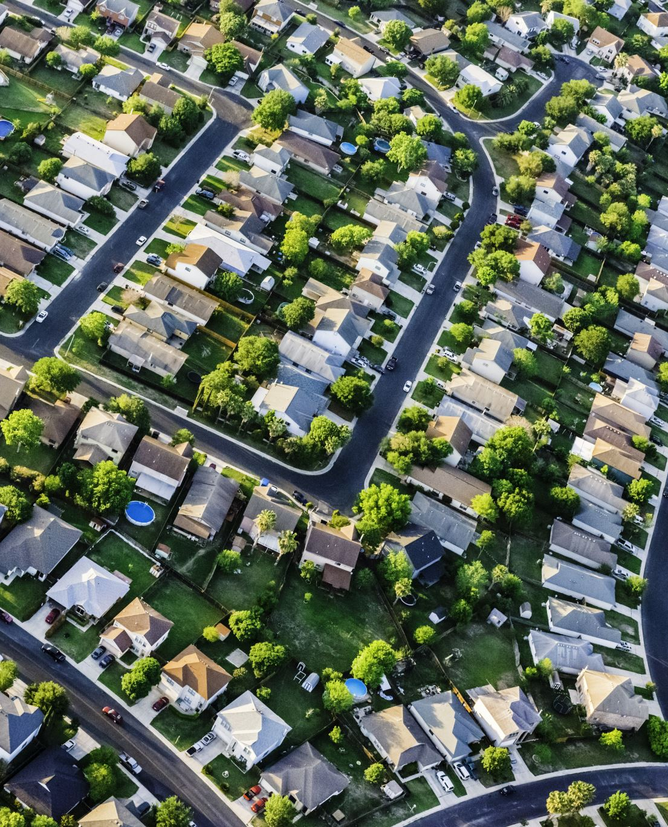
Piggybacks!
H.B. 96 gave county’s the opportunity to match the Owner Occupied and Homestead credits.
County Commissioners voted to create piggyback, county level credits to mirror the state credits.
Starting in 2026 those credits started – resulting in reduced tax bills for homeowners.

Slide 5
HB 186 – capping unvoted increases
Only impacts property taxes from voted (outside) millage
Caps property tax growth on voted levies related to the 20 –mill floor to the rate of inflation to prevent spikes in tax bills (GDP deflator)
Authorizes a property tax credit for eligible property located in a school district on the floor beginning in Tax Year 2025
Authorizes a retroactive property tax credit for eligible property located in a school district on the floor in counties with sexennial reappraisals or triennial updates in Tax Years 2023 and 2024
No credit if growth at the floor is less than inflation or if no longer at the floor
No corresponding adjustment to State foundation formula to account for inflation revenue cap, although cap adjusted for voluntarily foregone revenue H.B. 186 – Limitation on Floor Increases

Slide 6
Paid for by…
Cancelled expanded sales tax holiday in 2026 – return to three -day period
2026 Dates: Aug 7 -9

Slide 7
Increasing Owner Occupied Credit
Lowers Non-Business Credit Rate to 0% in TY 2029 – over a five-year period.
Increases Owner Occupancy Credit Rate from 2.50% in TY 2025 to 15.38% in TY 2029

Slide 8
HB 309 – Budget Commission
Allows county budget commissions to reduce voter -approved levies deemed as “unnecessary” or “excessive” after a public hearing and an opportunity for the taxing unit to provide relevant information at a public hearing
Levy cannot be reduced to an amount that would collect less than the preceding year unless there are reserve amounts, nonexpendable trust funds or carryover amounts to offset the reduction
Restricts reductions for new levies during the first year after voter approval
No school district can be reduced below the 20 -mill floor unless it so requests (if so, safe harbor to prevent a loss of State foundation funding)

Slide 9
Reappraisal Year Change
Next Lake County Sexennial Reappraisal moved from 2030 to 2031 by the Ohio Department of Taxation

Slide 10
Now What?
Proposed Legislation
Constitutional Amendment?

Slide 11
More legislation
H.B. 420 - Eliminates existing continuing property tax levies after Tax Year 2029 & Eliminates new continuing property tax levy options
H.B. 466 - Applies to libraries, township park districts, park districts created under RC Chapter 1545 and certain other entities (note: 144 of 251 libraries have a school district as their taxing authority). Requires approval of the body that created the entity before certification of the election proceedings to the board of elections
And many, many, more…
What’s need is REAL REFORM to the cost of government services

Slide 12
Proposed Constitutional Amendment
Would add new Section 14 to Article XII of the Constitution:
Section 14 Abolishment of Taxes on Real Property
(A) No real property shall be taxed, and no law shall impose any taxes on real property.
(B) No other provision of the Constitution shall impose any taxes on real property.
(C) As used in this Section, "real property" includes land itself, all growing crops therein, and all buildings, structures, and improvements permanently attached to the land.

Slide 13
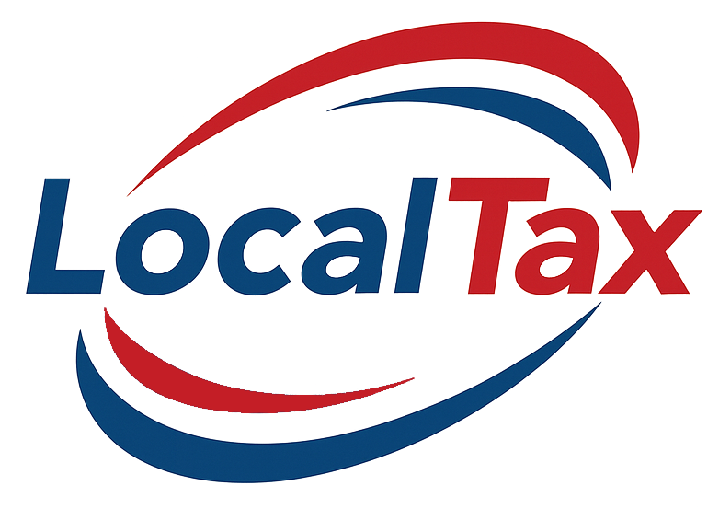

Local Taxes – What Does it Mean?
Not an even stool – property taxes: Generate about $24 billion annually , equal to the revenue from income taxes (~ $10.5 billion in FY2025) and sales taxes (~ $14 billion in FY2025) combined
Property taxes represent about 65% of local tax revenue in Ohio
Roughly 60-65% of local property tax revenue goes to school districts

Slide 14
Some possible outcomes
No viable replacement for property tax revenue if replaced by income tax. Per the Tax Foundation analysis estimates income tax rates of 11% -15% - potentially higher than any other state
Ohio reached a flat tax of 2.75% in 2026, the second lowest of any state that levies an income tax (9 states do not levy any income tax)
If replaced by sales tax, OBM estimates sales tax rates of 15% -18%, significantly higher than any other state (Ohio currently 21st)
Dramatically slash services at the local level?
Sources: Ohio Office of Budget & Management & The Tax Foundation

Slide 15
Real Challenges
Would only decrease revenue – no plan to adjust the cost side of the equation
No plan to address the billions in debt outstanding paid from and secured by property taxes
Would negatively impact credit ratings for many local governments, especially school districts
States are in competition on tax burdens – businesses and residents would possibly relocate and engage in tax avoidance measures

Slide 16
What I would do
Remove school funding from local property tax bills – give everyone a 60 – 65% tax cut immediately. School funding taken care of by the State of Ohio.
Consolidate school districts from 608 to 94 districts - and save $2B in administrative costs.
Reductions in local and county government infrastructure – Ohio has too many layers of government – costing us too much money! Worst in the United States!

